Slide 1
Machine Learning for
Anti-Money Laundering
Detection
From Transaction Classification to Network-Level Signal Discovery
Madhumitha Rajagopal

Slide 2
Introduction
Dataset & Features
Model Results
Key Insight
Research Proposal
Conclusion
Presentation Roadmap
01
04
The Problem
Critical Insight
Why rule-based AML systems fail at scale
PCA finding → nonlinear signal structure
02
05
Dataset & Features
Research Proposal
IBM AML dataset · 5M+ transactions · Feature engineering
Network topology as predictive signal
03
06
ML Model Comparison
Conclusion & Future Work
6 models tested · XGBoost results · Key metrics
Limitations · Extensions · Quant applications

Slide 3
Introduction
Dataset & Features
Model Results
Key Insight
Research Proposal
Conclusion
The Problem: Why Traditional AML Systems Fall Short
Traditional Rule-Based Approach
ML-Driven Goal
▸ Flag transactions > $10,000
Learn from patterns
Model complex nonlinear behaviors that rules cannot encode
▸ Flag high-risk country transfers
Scale to millions
▸ Flag rapid consecutive transfers
Process 5M+ transactions efficiently using PySpark pipeline
Why Criminals Adapt Easily
Reduce false positives
Precision-driven detection reduces costly manual reviews
✗ Break large sums into small transactions (smurfing)
Formal Task
✗ Route funds through chains of intermediary accounts
Given a transaction T, classify:
T → { Legitimate, Suspicious }
✗ Exploit static thresholds with minor variations
A binary classification problem on imbalanced financial data

Slide 4
Introduction
Dataset & Features
Model Results
Key Insight
Research Proposal
Conclusion
Dataset & Feature Engineering: IBM Anti-Money Laundering Dataset
5M+
~2%
8
PySpark
Transactions
Suspicious (imbalanced)
Raw Features
Processing Engine
Transaction Behavior
Network Behavior
Temporal Behavior
→ Transaction frequency per account
→ Number of unique counterparties
→ Burst transaction windows
→ Average transaction amount
→ Circular money flow patterns
→ Transactions at unusual hours
→ Deviation from historical baseline
→ Repeated transaction loops
→ Day-of-week anomalies
→ Transaction type distribution
→ Account fan-in / fan-out ratio
→ Time gap between transfers
Preprocessing Pipeline:
Missing value handling → One-Hot Encoding of categoricals → PCA for dimensionality reduction → 80/20 train-test split

Slide 5
Introduction
Dataset & Features
Model Results
Key Insight
Research Proposal
Conclusion
Model Selection: Benchmarking Six Algorithms
Logistic
Regression
K-Nearest
Neighbors
Support
Vector
Machine
Decision
Tree
XGBoost
Neural
Network
(PyTorch)
Model Performance Comparison
Why XGBoost Won
Model
Accuracy
F1 Score
Notes
Sequential boosting
Logistic Regression
72%
0.68
Baseline
Each tree corrects errors of the previous — iteratively improving on hard-to-classify transactions
KNN
74%
0.70
Slow on 5M rows
Imbalance robustness
Naturally handles skewed class distributions without needing explicit resampling
SVM
78%
0.74
High compute cost
Nonlinear interactions
Decision Tree
80%
0.76
Overfits
Captures complex feature combinations that linear models fundamentally cannot represent
Neural Network
85%
0.82
Slower, no gain
Tabular data dominance
XGBoost ★
89%
0.85
Best performer
Deep learning showed no improvement — tree ensembles remain state-of-the-art for financial tabular data

Slide 6
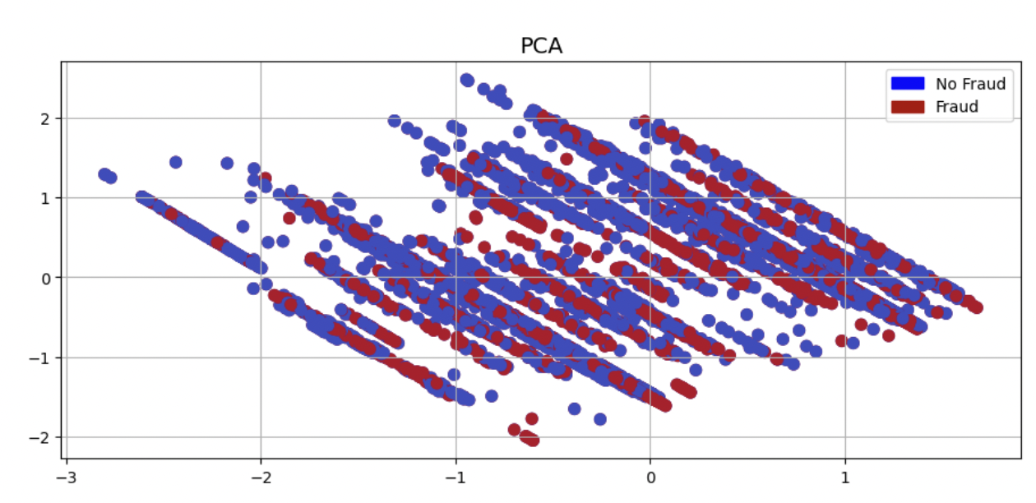
Introduction
Dataset & Features
Model Results
Key Insight
Research Proposal
Conclusion
Key Research Insight: Hidden Complexity in Transaction Data
The Finding
What This Means
When PCA was applied to visualize transactions in lower dimensions, fraudulent and non-fraudulent transactions showed significant overlap — they were NOT linearly separable.
Signal is nonlinear
Simple linear boundaries cannot separate suspicious from normal — the patterns are too complex
Laundering is interaction-driven
The signal lives in combinations of features and accounts, not single transaction flags
XGBoost is the right tool
Tree ensembles capture non-linear feature interactions that linear models fundamentally miss
"This insight raised a deeper question: are we looking at the right level of abstraction? What if the real signal lives in the network structure — not individual transactions?"

Slide 7
Introduction
Dataset & Features
Model Results
Key Insight
Research Proposal
Conclusion
Research Proposal: Transaction Network Topology as Predictive Signal
Research Question:
Can graph-based features extracted from financial transaction networks generate predictive signals for abnormal financial behavior — earlier and more robustly than individual transaction features?
STEP 1
STEP 2
STEP 3
STEP 4
Transaction Network Structure
Build Transaction Graph
Extract Network Features
Graph Embeddings
Generate Signals
Acct A
Acct B
Embeddings fed into
classifier to flag
suspicious clusters
PageRank · Betweenness
centrality · Eigenvector
centrality · Clustering coeff.
Node2Vec / DeepWalk
convert topology into
dense feature vectors
Daily directed graph:
accounts as nodes,
transactions as weighted edges
Origin
HUB
Receiver
Acct D
High PageRank
Acct C
Exit
Layering
● Nodes = Accounts → Edges = Transactions ⟳ Cycle = Laundering Ring
Why this is novel:
Laundering rings often form tightly connected subgraphs. Network metrics such as centrality and PageRank can expose coordinated financial activity earlier than transaction-level signals alone — catching suspicious behavior before it becomes detectable at the transaction level.

Slide 8
Introduction
Dataset & Features
Model Results
Key Insight
Research Proposal
Conclusion
Network Feature Engineering: What the Graph Tells Us
PR
PageRank
BC
Betweenness Centrality
Accounts connected to many influential nodes receive higher PageRank — reflecting their structural importance in the transaction network.
Measures how often an account acts as a bridge between senders and receivers across the network.
▶ Signal: Dormant account suddenly becomes central in the transaction network
▶ Signal: High betweenness with low transaction volume → potential layering account
CC
Clustering Coefficient
TC
Transaction Cycles
Measures how tightly connected an account's neighbors are — high values indicate dense, self-referential transaction clusters.
Detects funds returning to their origin account after multiple hops — a hallmark pattern of financial layering.
▶ Signal: High clustering + circular flows → potential laundering ring
▶ Signal: Money completes a circuit back to origin — a hallmark of layering

Slide 9
Introduction
Dataset & Features
Model Results
Key Insight
Research Proposal
Conclusion
Conclusion & Future Research Directions
What This Project Demonstrated
Future Research Directions
✓ Scalable ML pipeline processing 5M+ transactions via PySpark
Dynamic Graph Signals
Track how network centrality evolves over rolling windows to detect emerging laundering rings before transaction patterns crystallize
✓ XGBoost achieved best performance (89% accuracy, F1 ≈ 0.85)
✓ PCA analysis suggested nonlinear signal structure
GNN-Based Detection
Graph Neural Networks learn directly from the transaction graph, building structural embeddings end-to-end without manual feature design
✓ Feature engineering across behavioral, network and temporal dimensions
Temporal Attention Models
Limitations
Apply transformer attention to account transaction sequences, treating financial history as language and laundering as anomalous grammar
⚠ Simulated dataset — real-world noise may reduce performance
⚠ PCA may discard financially meaningful features
"What excites me most about this direction is that the signal isn't hiding in individual transactions. It's in how accounts connect to each other."
⚠ No temporal graph evolution tracked across time

Slide 10
Thank You
Open for Questions and Discussion

